Slide 1
Circuits I

Slide 2
Moving charges: Electric Current
Path of moving charges: circuit
Transporting energy
Current
http://dananne.org/dart/randomwalk/web/randomwalk.html
Random walk does not mean ‘no progression’
Random motion fast: 10⁶m/s
Drift speed slow: 10⁻⁴m/s
e⁻ typically moves only few cm
Positive current direction:= direction flow + charge

Slide 3
Work done by E on moving charges → heat
(average vibrational energy increased i.e. temperature)
Current through A:= dQ/dt
charge through A per unit time
Unit [A] ‘Ampere’
[A] = [C/s]
Current and current density do
not depend on sign of charge
→ Replace q by /q/
Concentration of charges n [m⁻³] , all move with v_{d}, in dt moves v_{d}dt,
volume Av_{d}dt, number of particles in volume n Av_{d}dt
What is charge that flows out of volume?
dQ = q (n Av_{d}dt) → current dQ/dt = n qv_{d}A
Current density [A/m²] J = I/A = nqv_{d}

Slide 4
Resistivity and Resistance
Properties of material matter too:
For metals, at T = const. J= nqv_{d} ~ E
Proportionality constant ρ is resistivity ρ = E/J Ohm’s law
Reciprocal of ρ is conductivity
Unit ρ: [Ωm] ‘Ohm’ = [(V/m) / (A/m²)] = [Vm/A]

Slide 5
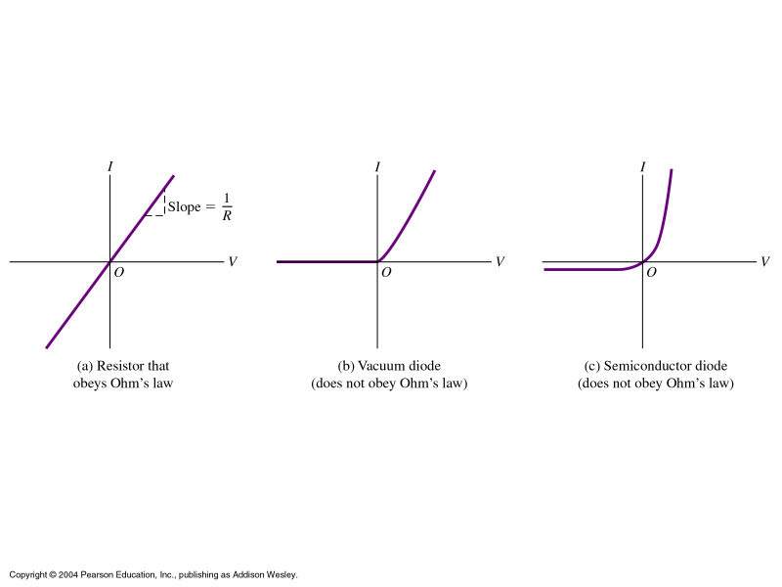
Types of resistivity

Slide 6
Resistance
Ask for total current in and
potential at ends of conductor:
Relate value of current to
Potential difference between ends.
For uniform J,E
I = JA and V =EL
with Ohm’s law E=ρJ
V/L = ρI/A
Const. ρ → I ~ V
‘resistance’ R = V/I [Ω]
vs. R
R =ρL/A
R = V/I
V = R I
I = V/R

Slide 7
Electromotive Force
Steady currents require circuits: closed loops of conducting material
otherwise current dies down after short time
Charges which do a full loop
must have unchanged potential
energy
Resistance always reduces U
A part of circuit is needed which
increases U again
This is done by the emf.
Note that it is NOT a force but
a potential!
First, we consider ideal sources (emf) : V_{ab} = E = IR

Slide 8
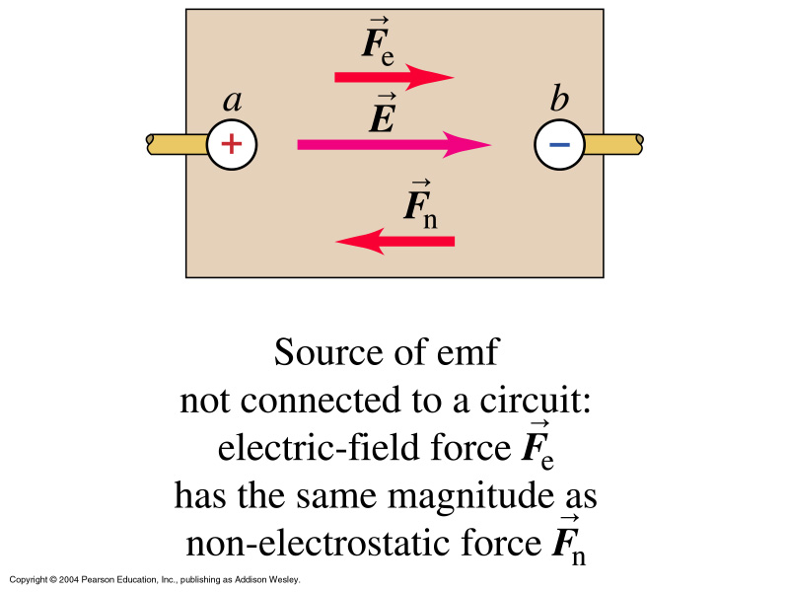
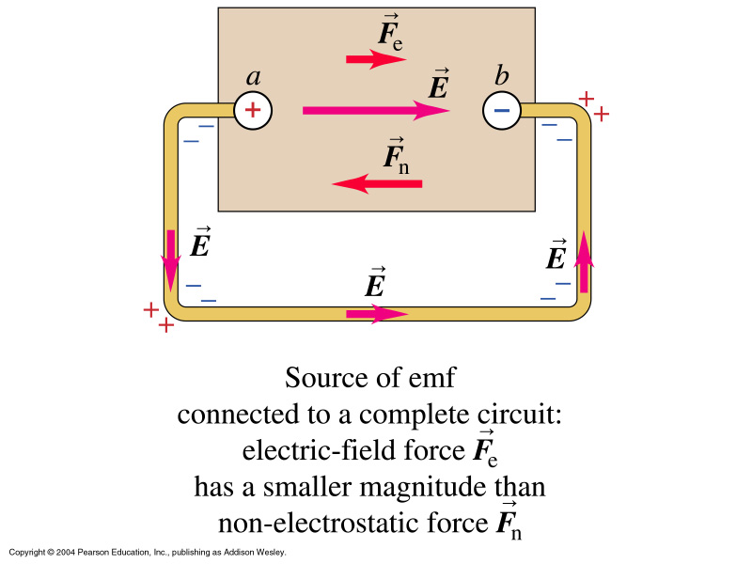
I is not used up while flowing from + to –
I is the same everywhere in the circuit
Emf can be battery (chemical), photovoltaic (sun energy/chemical),
from other circuit (electrical), every unit which can create em energy
EMF sources usually possess Internal Resistance. Then,
V_{ab} = E – Ir and I = E/(R+r)

Slide 9
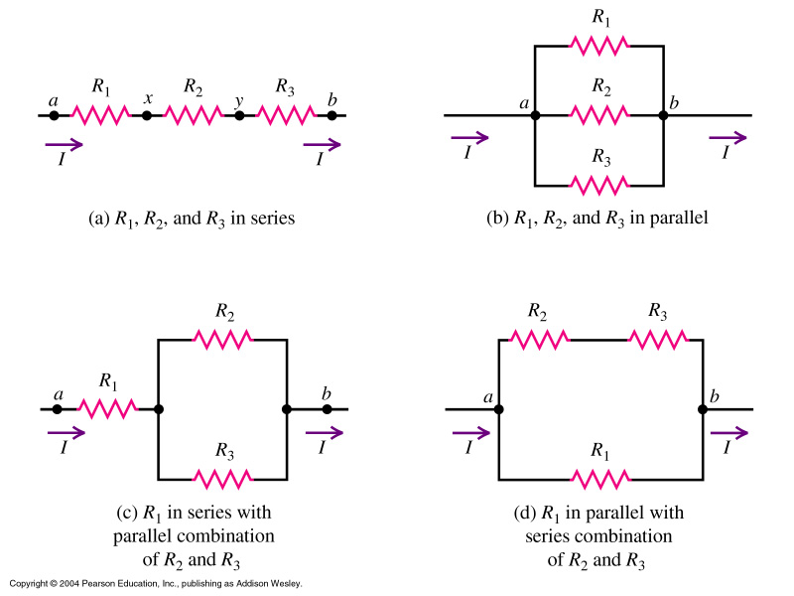
Resistor networks
Careful: opposite to capacitor series/parallel rules!

Slide 10
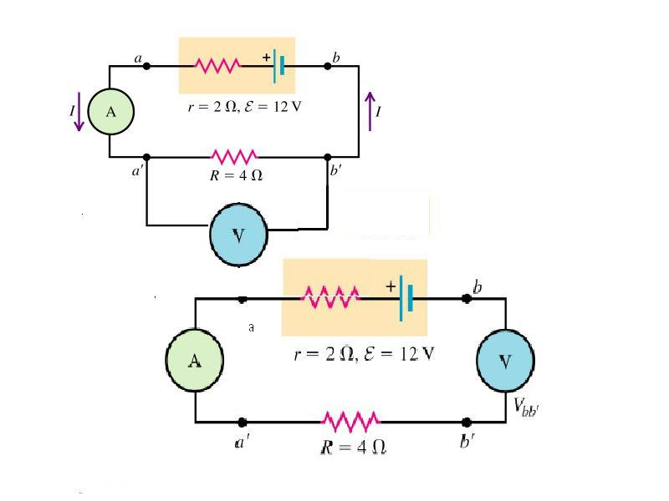
Circuit Diagrams
I = E/(R+r) = 2A
V_{a’b’}= V_{ab} = IR = E-Ir = 8V
(Ideal wires and am-meters have
Zero resistance)
No I through voltmeter
(infinite R) …
i.e. no current at all
V_{a’b’} = IR = 0 = V_{aa’}
V_{bb’} = V_{ab}
Voltage is always measured in parallel, amps in series

Slide 11
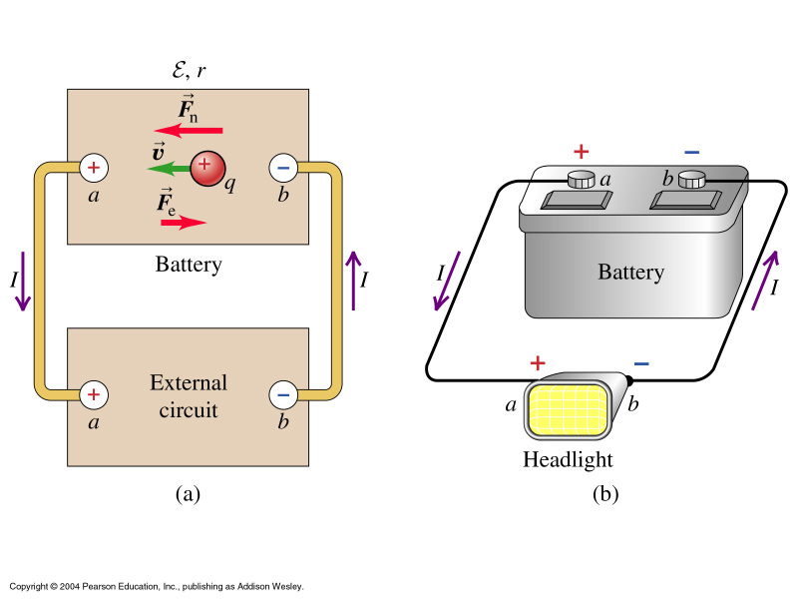
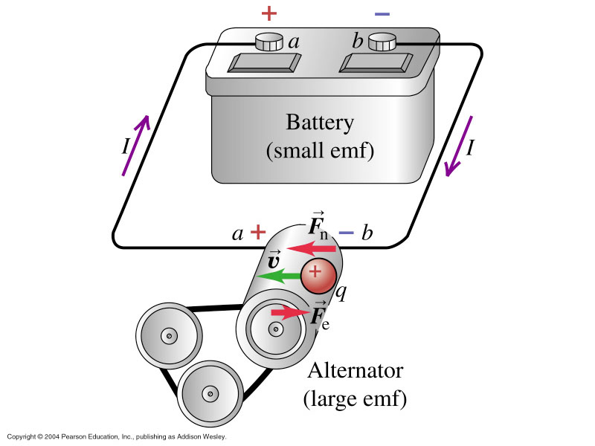
Energy and Power in Circuits
Rate of conversion to electric energy: EI, rate of dissipation I²r –
difference = power output source
When 2 sources are connected to simple loop:
Larger emf delivers to smaller emf

Slide 12
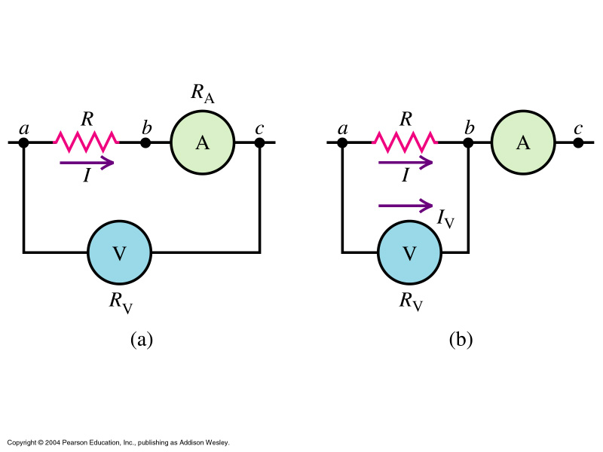
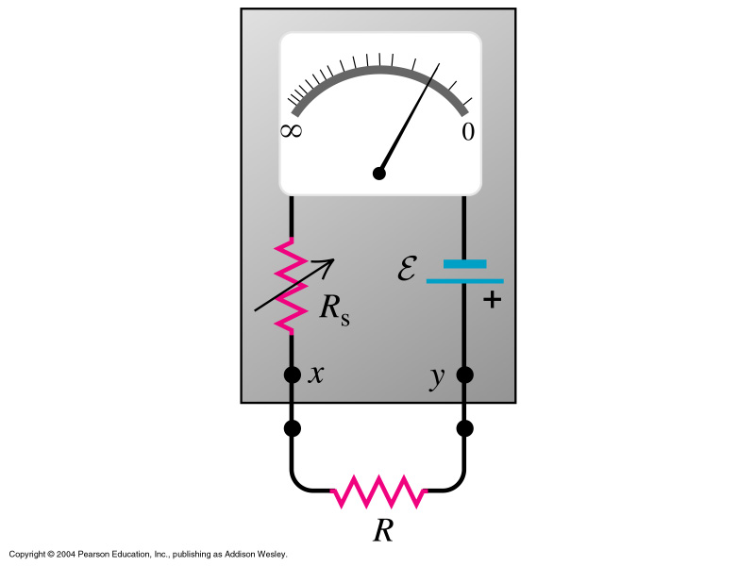
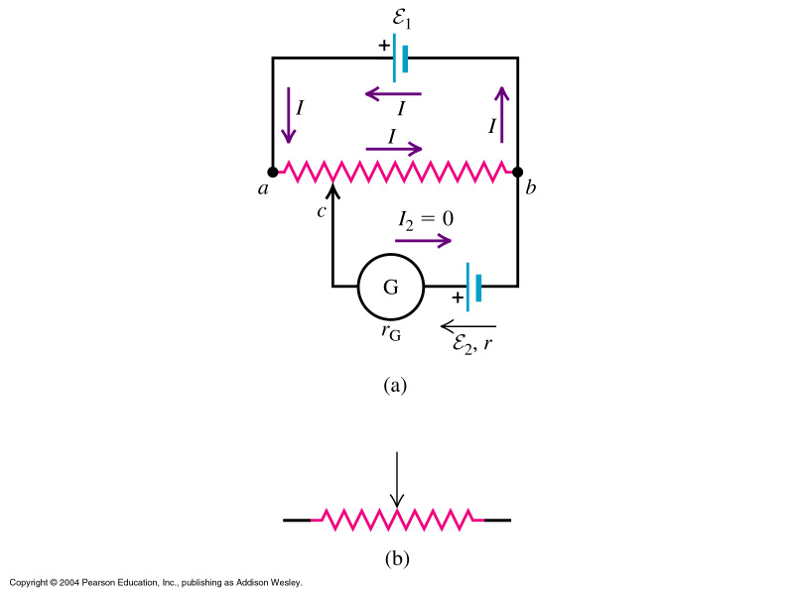
Combining Measuring Instruments

Slide 13
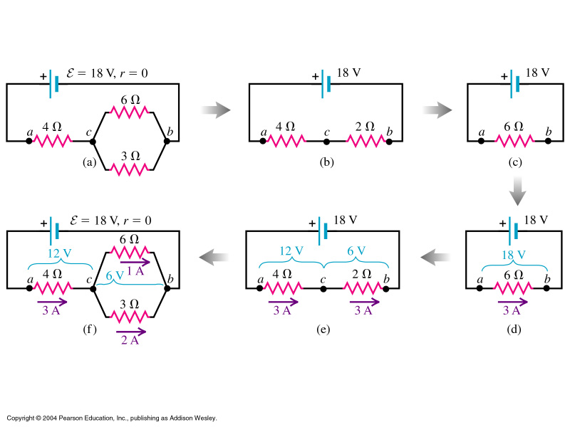
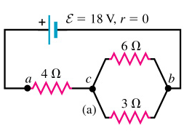
Group Task:
Find R_{eq} and I and V across
/through each resistor!

Slide 14
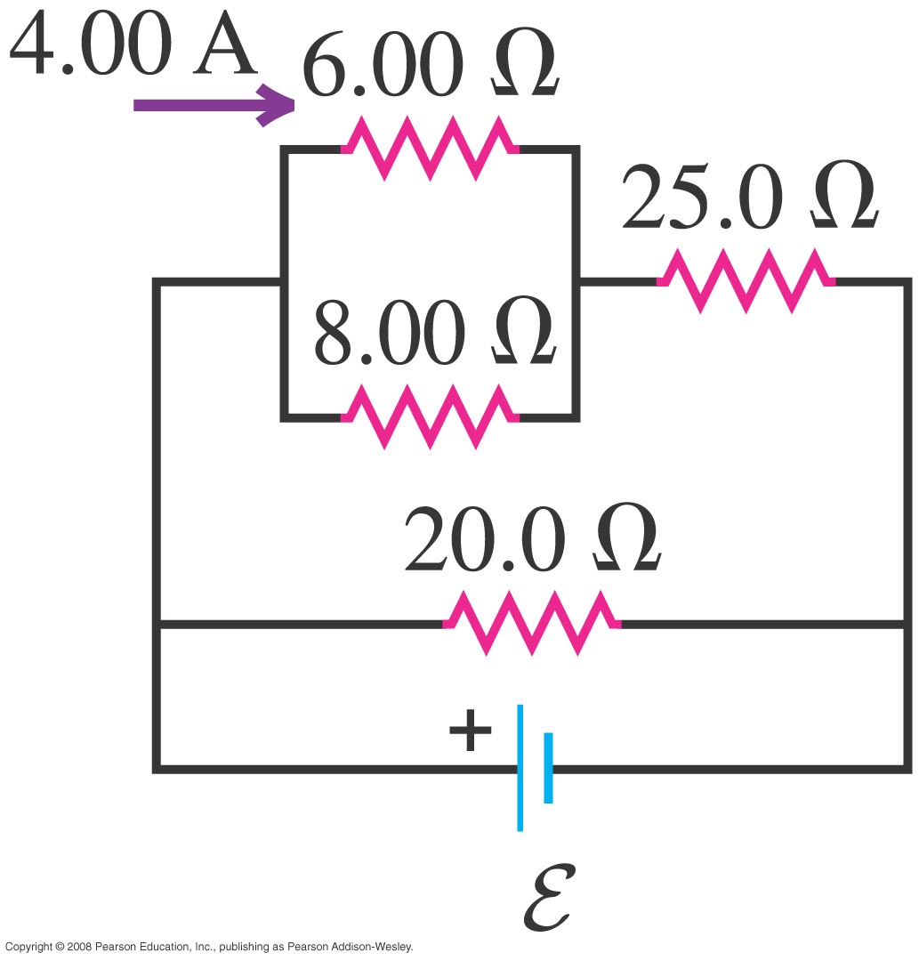
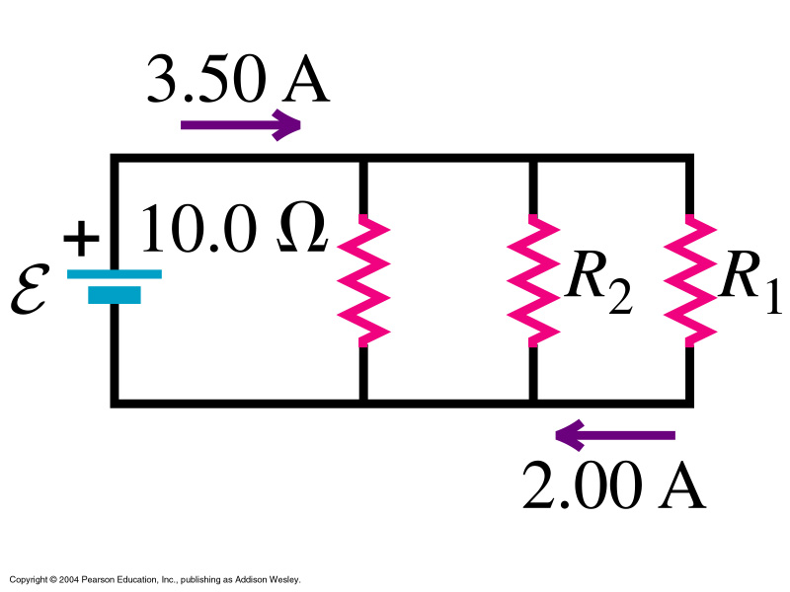
Group task:
Find I₂₅ and I₂₀

Slide 15
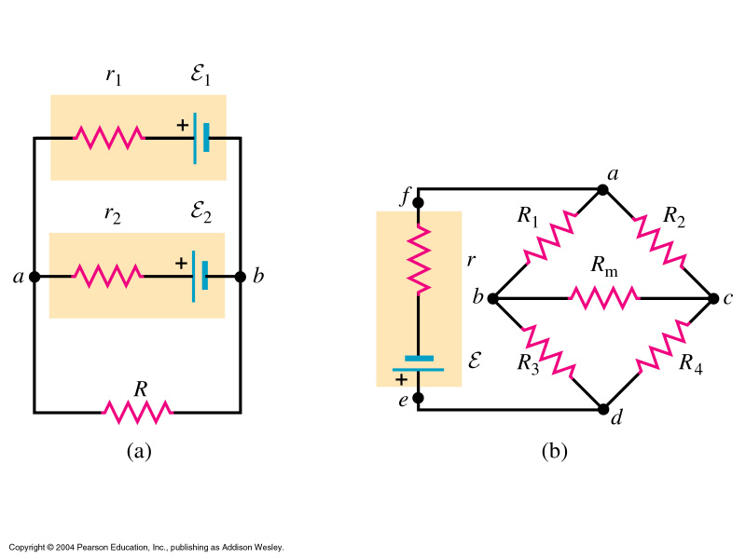
Kirchhoff’s Rules
A more general approach to analyze resistor networks
Is to look at them as loops and junctions:
This method works even
when our rules to reduce
a circuit to its R_{eq}
fails.

Slide 16
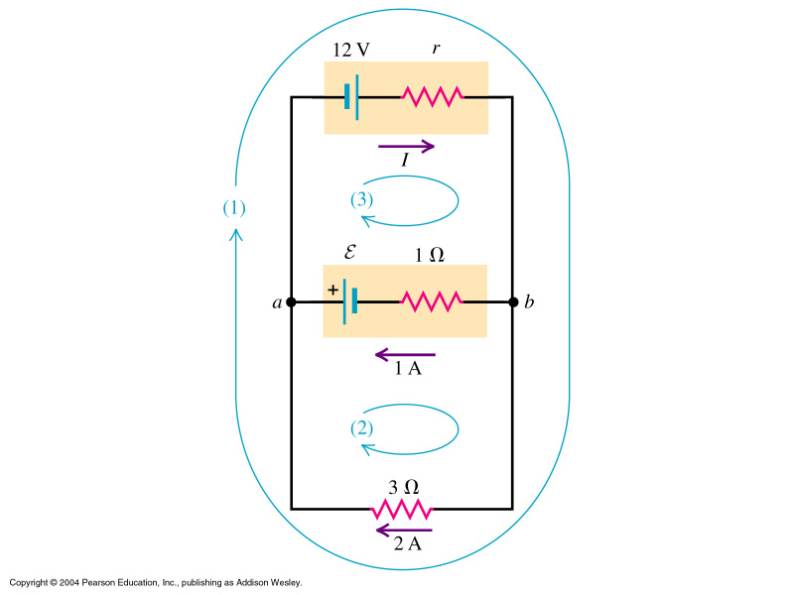
‘Charging a battery’
Circuit with more
than one loop!
Apply both rules.
Junction rule,
point a:
-I + 1A + 2A =0
I = 3A
[Similarly point b:
I – 1A – 2A = 0]
Loop rule: 3 loops
to choose from
‘1’: decide direction
in loop – clockwise
(sets signs!)
12V – 3A r
– 2A 3Ω = 0
r = 2Ω
Find E from loop 2:
Lets do the loop counterclockwise: E -1A1Ω +2A3Ω =0 → E = -5V

Slide 17
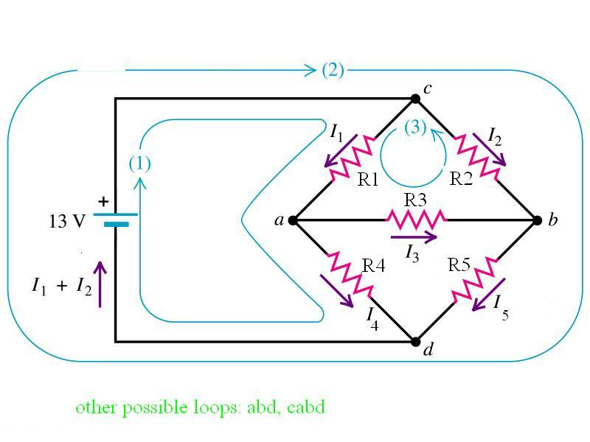
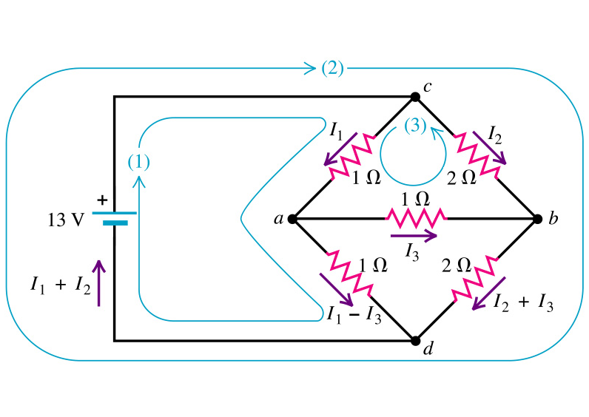
Group task: Find values of I1,I2,and I3!
5 currents
Use junction rule
at a, b and c
3 unknown currents
Need 3 eqn
Loop rule to 3 loops:
cad-source
cbd-source
cab
(3 bec.of no.unknowns)
13V -I₁R₁-(I₁-I₃)R₄ =0
-I₂R₂-(I₂+I₃)R₅+13V=0
-I₁R₁-I₃R₃+I₂R₂ =0
Let’s set R₁=R₃=R₄=1Ω
And R₂=R₅=2Ω
Solve for one I and
substitute in other eqn
(use easiest)
I₂= ½ (I₁+I₃)
I₁ = 6.5A, I₂ = 3.25A, I₃ = 0

Slide 18
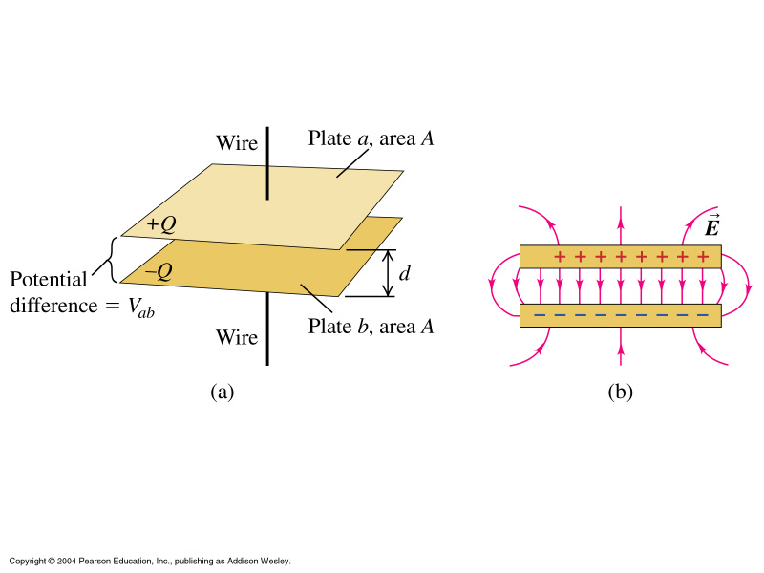
Capacitance
E ~ /Q/ → V_{ab} ~ /Q/
Double Q:
Charge density, E, V_{ab}
double too
But ratio Q/V_{ab} is constant
Capacitance is measure of ability of a capacitor to store energy!
(because higher C = higher Q per V_{ab} = higher energy
Value of C depends on geometry (distance plates, size plates, and material
property of plate material)

Slide 19
Plate Capacitors
E = σ/ε₀
= Q/Aε₀
For uniform field E and given plate distance d
V_{ab} = E d
= 1/ε₀ (Qd)/A
Units: [F] = [C²/Nm] = [C²/J] … typically micro or nano Farad

Slide 20
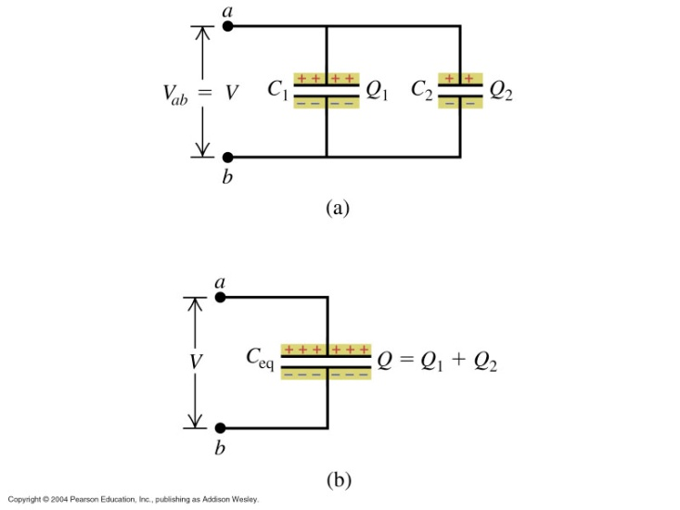
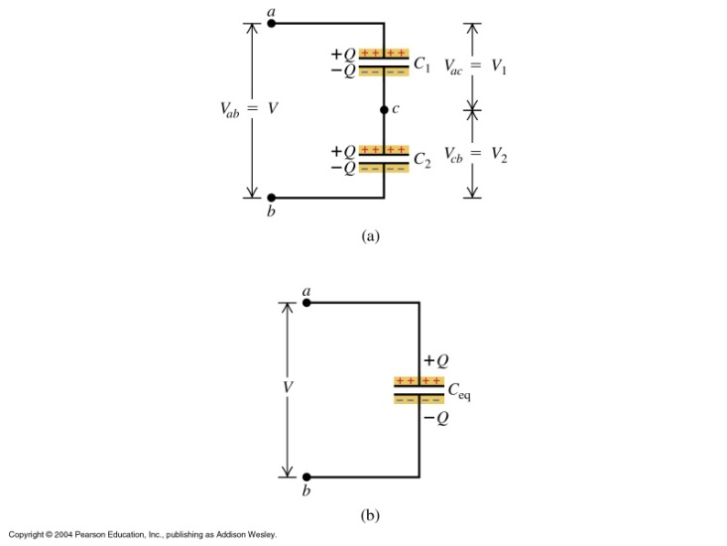
Capacitor Networks
In a series connection, the magnitude of charge on all plates is the same. The potential differences are not the same.
V_{ac} = Q/C₁, V_{cb} = Q/C₂ V_{ab} = Q (1/C₁ + 1/C₂)
Or using concept of equivalent capacitance
1/C_{eq} = 1/C₁ + 1/C₂ + …
In a parallel connection, the potential difference for all individual capacitors is the same. The charges are not the same.
Q₁ = C₁ V, Q₂ = C₂ V Q = (C₁ + C₂) V
Or C_{eq} = C₁ + C₂ + …

Slide 21
Equivalent capacitance is used to simplify networks.
Group task: What is the equivalent capacitance
of the circuit below?
Step 1:
Find equivalent for C series at right
Hand. 1/C = 1/12 + 1/6 [μF]
Step 2:
Find equivalent for C parallel
left to right.
C = 3 + 11 + 4 [μF]
Step 3:
Find equivalent for series.
C = 1/18 + 1/9 [μF]
= 6 μF
Solution: parallel branch … 10+5= 15
series branch … 1/20 + 1/10 = 1/C
→ C = 20/3
→ total: 2 branches in series 1/15 + 3/20
C_{tot} = 60/(4+9)

Slide 22
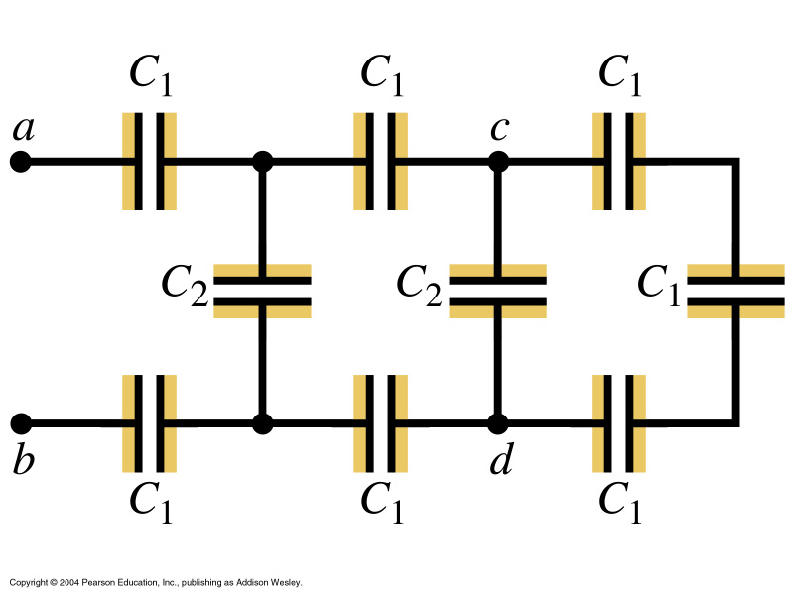
Capacitor Networks
24.63
C1 = 6.9 μF, C2= 4.6μF
Reducing the furthest right leg
(branch):
C=(1/6.9 + 1/6.9 + 1/6.9)⁻¹ = 2.3μF
Combines parallel with nearest C2:
C = C1_{eq}+C2 = 6.9μF
Leaving a situation identical to what we have just worked out:
1/6.9 + 1/6.9 + 1/6.9 = 2.3 μF
And again 2.3+4.6 = C_{eq,2} = 6.9 μF
So the overall C_{EQ} = 2.3 μF
Charge on C1 and C2:
Q_{C1} = C_{EQ}V, for V=420V →0.97 mC
Q_{C2} = C₂V₂ = 4.6μF * 420/3 = 0.644 mC
For V_{ab} = 420[V], V_{cd}=?
V_{ac} = V_{bd} = 1/3 (420[V]), V_{cd}= 1/3 (1/3 420[V]))

Slide 23
Energy Storage in Capacitors
V = Q/C
W = 1/C int_{0Q} [q dq] = Q²/2C

Slide 24
Energy Storage in Capacitors
24.24: plate C 920 pF, charge on each plate 2.55 μC
V between plates:
V = Q/C = 2.55 10⁻⁶C/0.920 10⁻⁹F
= 2.772 kV
b)For constant charge, if d is doubled, what will V be?
If q is constant, C must be halved and V doubled: 5.544 kV
c) How much work to double d?
U = ½ C V² = 3.53 mJ
If d is doubled, C → ½ C → U doubles
Work equals amount of extra energy needed which is 3.53 mJ

Slide 25
Other common geometries
Spherical capacitor
Need V_{ab} for C, need E for V_{ab}:
Take Gaussian surface as sphere
and find enclosed charge
E dA = E 4πr² = Q/ε₀ → E
V_{a} – V_{b} = Q/4πε₀r_{a}- Q/4πε₀r_{b}
= q/4πε₀ [(r_{b}-r_{a})/r_{a}r_{b}]
C = Q/V_{ab} = 4πε₀ r_{a}r_{b}/(r_{b}-r_{a})
Note: independent of Q and V
again.
Cylindrical capacitor
Find E E_{r} = λ/2πε₀ 1/r
Find V V_{ab} = λ/2πε₀ lnr_{b}/r_{a}
Find C Q = λL, C = 2πε₀L/ ln(r_{b}/r_{a})
What is C dep. On?

Slide 26
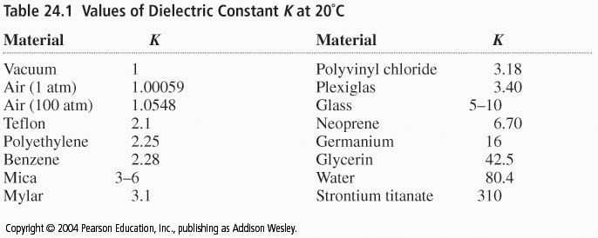
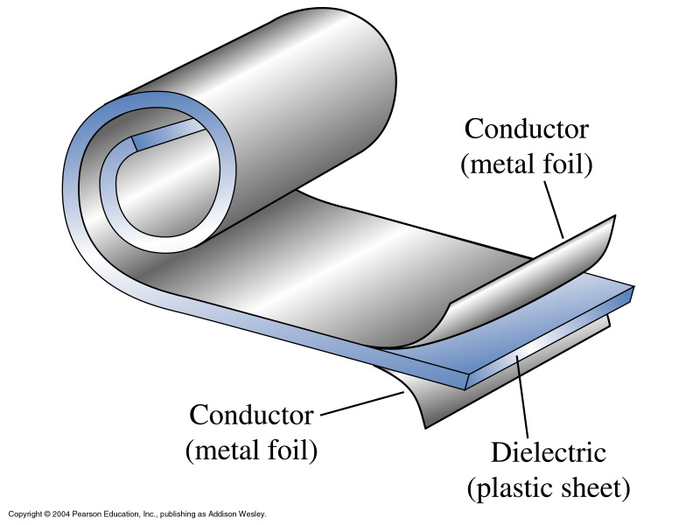
Dielectrics
Dielectric constant K
K= C/C₀
For constant charge:
Q=C₀V₀=CV
And V = V₀/K
Dielectrics are never
perfect insulators: material
leaks

Slide 27
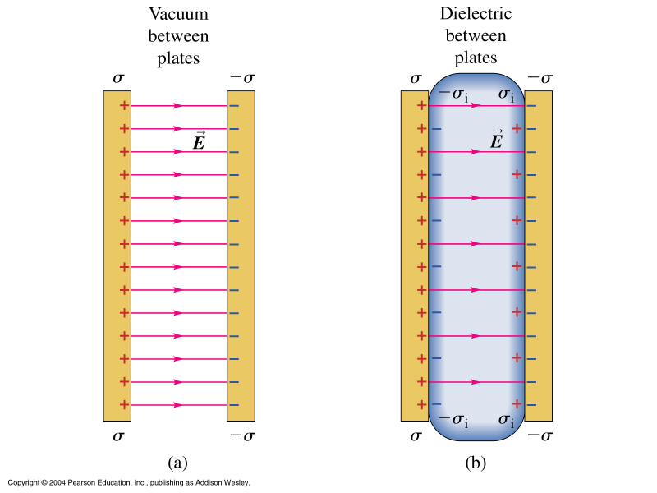
Induced charge: Polarization
If V changes with K, E must decrease too: E = E₀/K
This can be visually understood considering that materials
are made up of atoms and molecules:

Slide 28
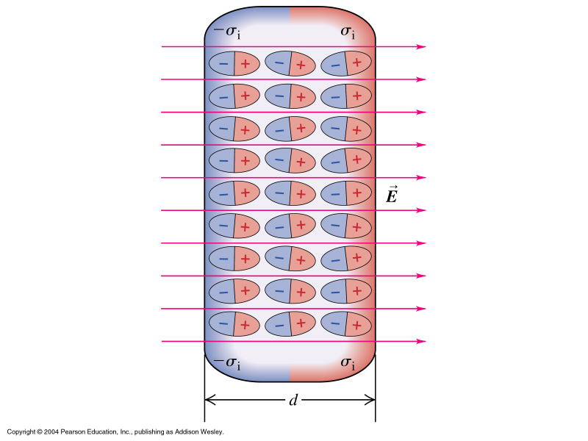
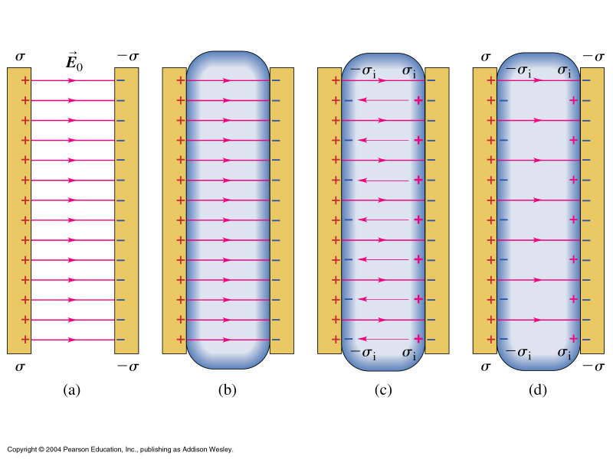
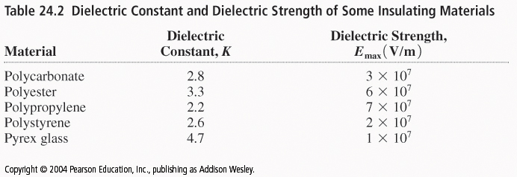
Induced charge: Polarization – Molecular View
Dielectric breakdown

Slide 29
Change with dielectric:
E₀ = σ/ε₀ → E = (σ−σ_{i})/ε₀ and = E₀/K
σ−σ_{i} = ε₀E₀/K → σ_{i} = σ −σ/K
σ_{i} = σ (1-1/K)
E = σ/ε
Empty space: K=1, ε=ε₀

Slide 30
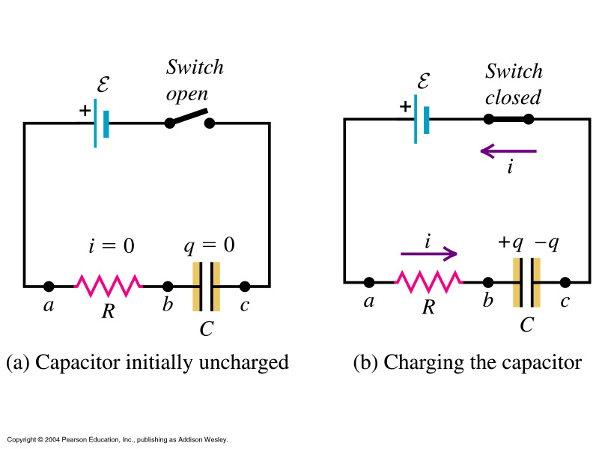
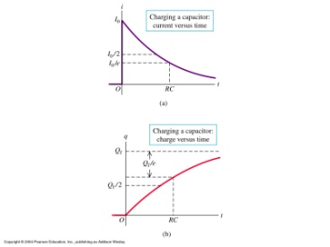
RC Circuits
From now on
instantaneous
Quantities I and V
in small fonts
v_{ab} = i R
v_{bc} = q/C
Kirchhoff:
E – iR –q/C = 0
i = E/R – q/RC
As q increases
towards Q_{f},
i decreases → 0
Charging a capacitor
Separate variables:
Integrate, take exp.:

Slide 31
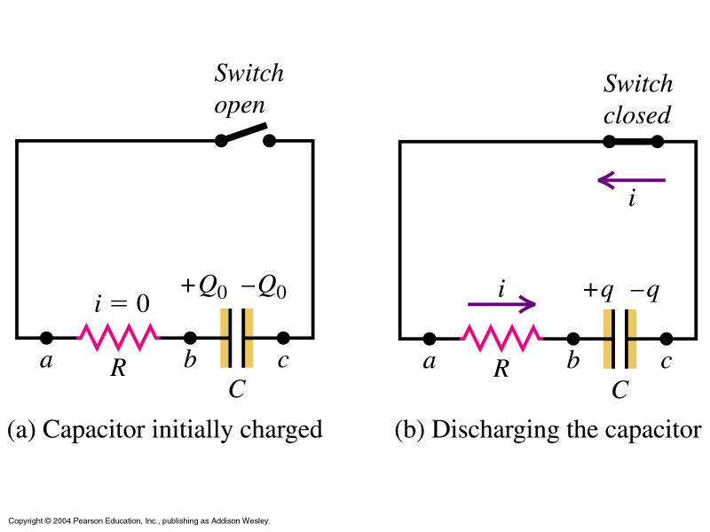
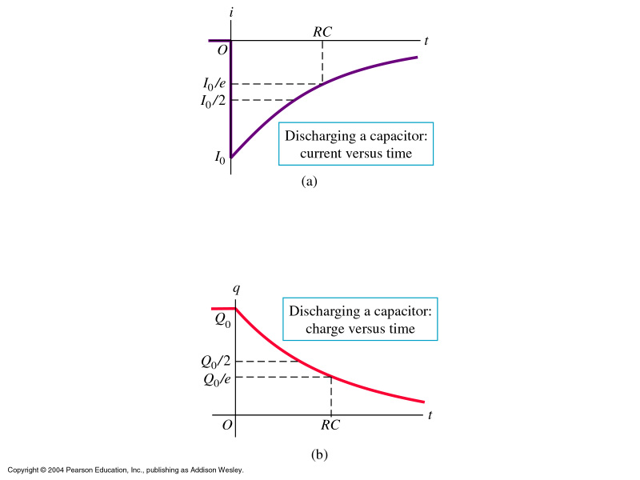
Characteristic time constant τ = RC !
Discharging a capacitor

Slide 32
Ex 26.37 - C= 455 [pF] charged with 65.5 [nC] per plate
C then connected to ‘V’ with R= 1.28 [MΩ]
i_{initial}?
b) What is the time constant of RC?
i = q/(RC) = 6.55 10⁻⁸ [C] / (1.28 10⁶ [Ω] 4.55 10⁻¹⁰[F])
= 1.12 10⁻⁴[A]
[C/(ΩF] =! [A]
b) τ = RC = 1.28 10⁶ [Ω] 4.55 10⁻¹⁰ [F] = 0.582 [ms]
Group Task:
Find τ
charged fully after 1[hr]? Y/N

Slide 33
Ex 26.82 C= 2.36 [μF] uncharged, then connected in series to
R= 4.26 [Ω] and E=120 [V], r=0
Rate at which energy is dissipated at R
b) Rate at which energy is stored in C increases
c) Power output source
a) P_{R} = V²/R = (120[V])² = 3.38 [kW]
b) P_{C}= dU/dt = 1/(2C) d(q²)/dt = iq/C = 0
c) P_{τ} = E I = 120[V] (120[V]/4.26[Ω]) = 3.38 [kW]
d) What is the answer to the questions after ‘a long time’?
→ all zero
Initially all the power output of the source is dissipated in the resistor.
After a long time energy is stored in the capacitor but the amount stored
isn't changing.
Group Task

